Slide 1
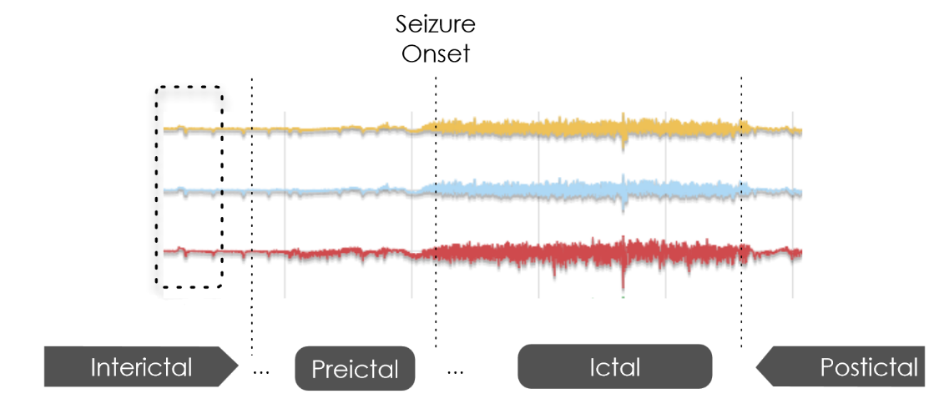
Epileptic Seizure Prediction
We want to develop a early seizure warning prediction system for epileptic patients using a machine learning approach.
Identification of a preictal state can be used to notify patients of oncoming seizures so that they are better prepared.
iEEG data from epileptic dogs will be used as a model system, we will later expand this to humans.
Data is provided through kaggle.com by the International Epilepsy Electrophysiology Portal
iEEG data is available from 5 dogs (2.5GB – 10GB) and 2 human patients (13GB – 14GB)
Data segments are divided into interictal and preictal categories for training and tests
We will use fast Fourier transform to preprocess the data and use a support vector machine algorithm to identify interictal and preictal states.
http://www.uc.pt/en/fctuc/dei/ensino/doctoral_program/colloquiumbrunodireito
By: Taylor Neely & Jack Terwilliger

